Slide 1
Outside the safe operating space of a new planetary boundary for PFAS
Ian T. Cousins
Department of Environmental Science,
Stockholm University, Sweden
CHE, October 6th, 2022

Slide 2
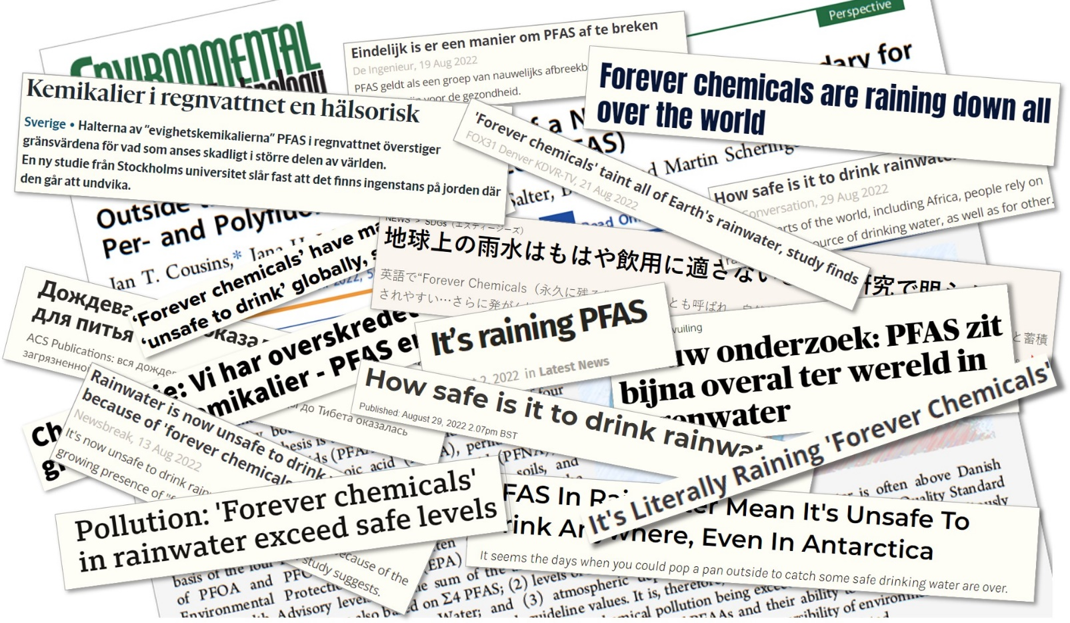
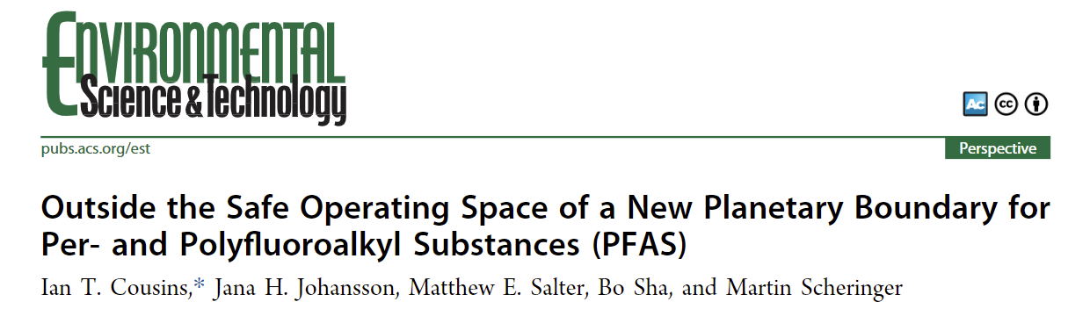
To date:
194 000 downloads
306 news articles

Slide 3
Hypotheses
Ambient levels of PFOS, PFOA, PFHxS and PFNA are above the most stringent guidelines/health advisories
Environmental resources on Earth irreversibly contaminated to the point where we’re concerned about using them
  new planetary boundary for PFAS exceeded

Slide 4
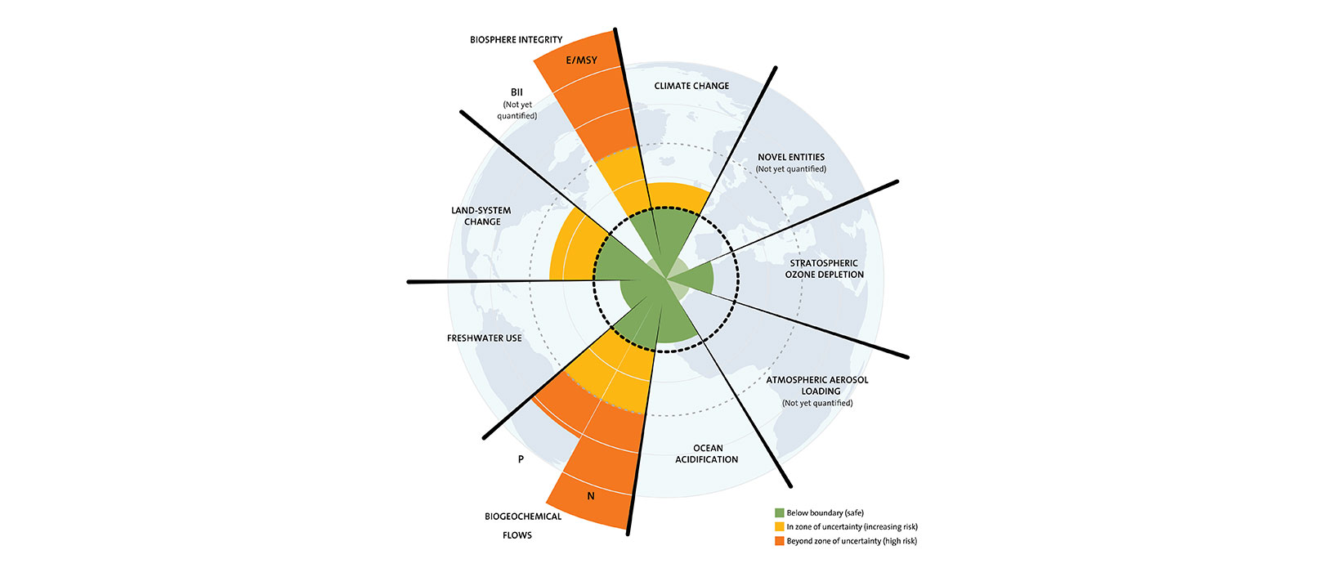
Planetary Boundaries
In the planetary boundary concept, an attempt is made to estimate the boundaries for “a safe operating space for humanity”

Slide 5
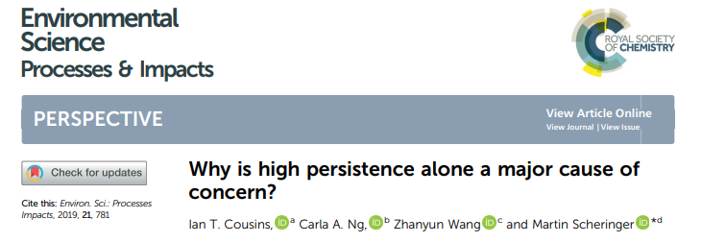
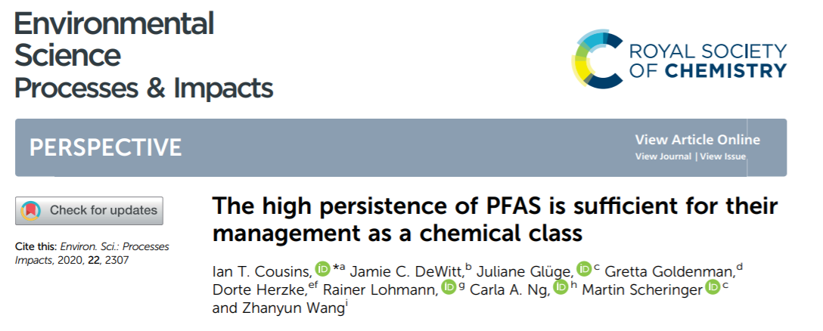
Highly predictable problem!
All PFAS are highly persistent (EU REACH)
  either non-degradable or transform ultimately into stable terminal transformation products
Continual release results in global spread, increasing levels and increasing probabilities of known and unknown effects.
Exposure poorly reversible

Slide 6
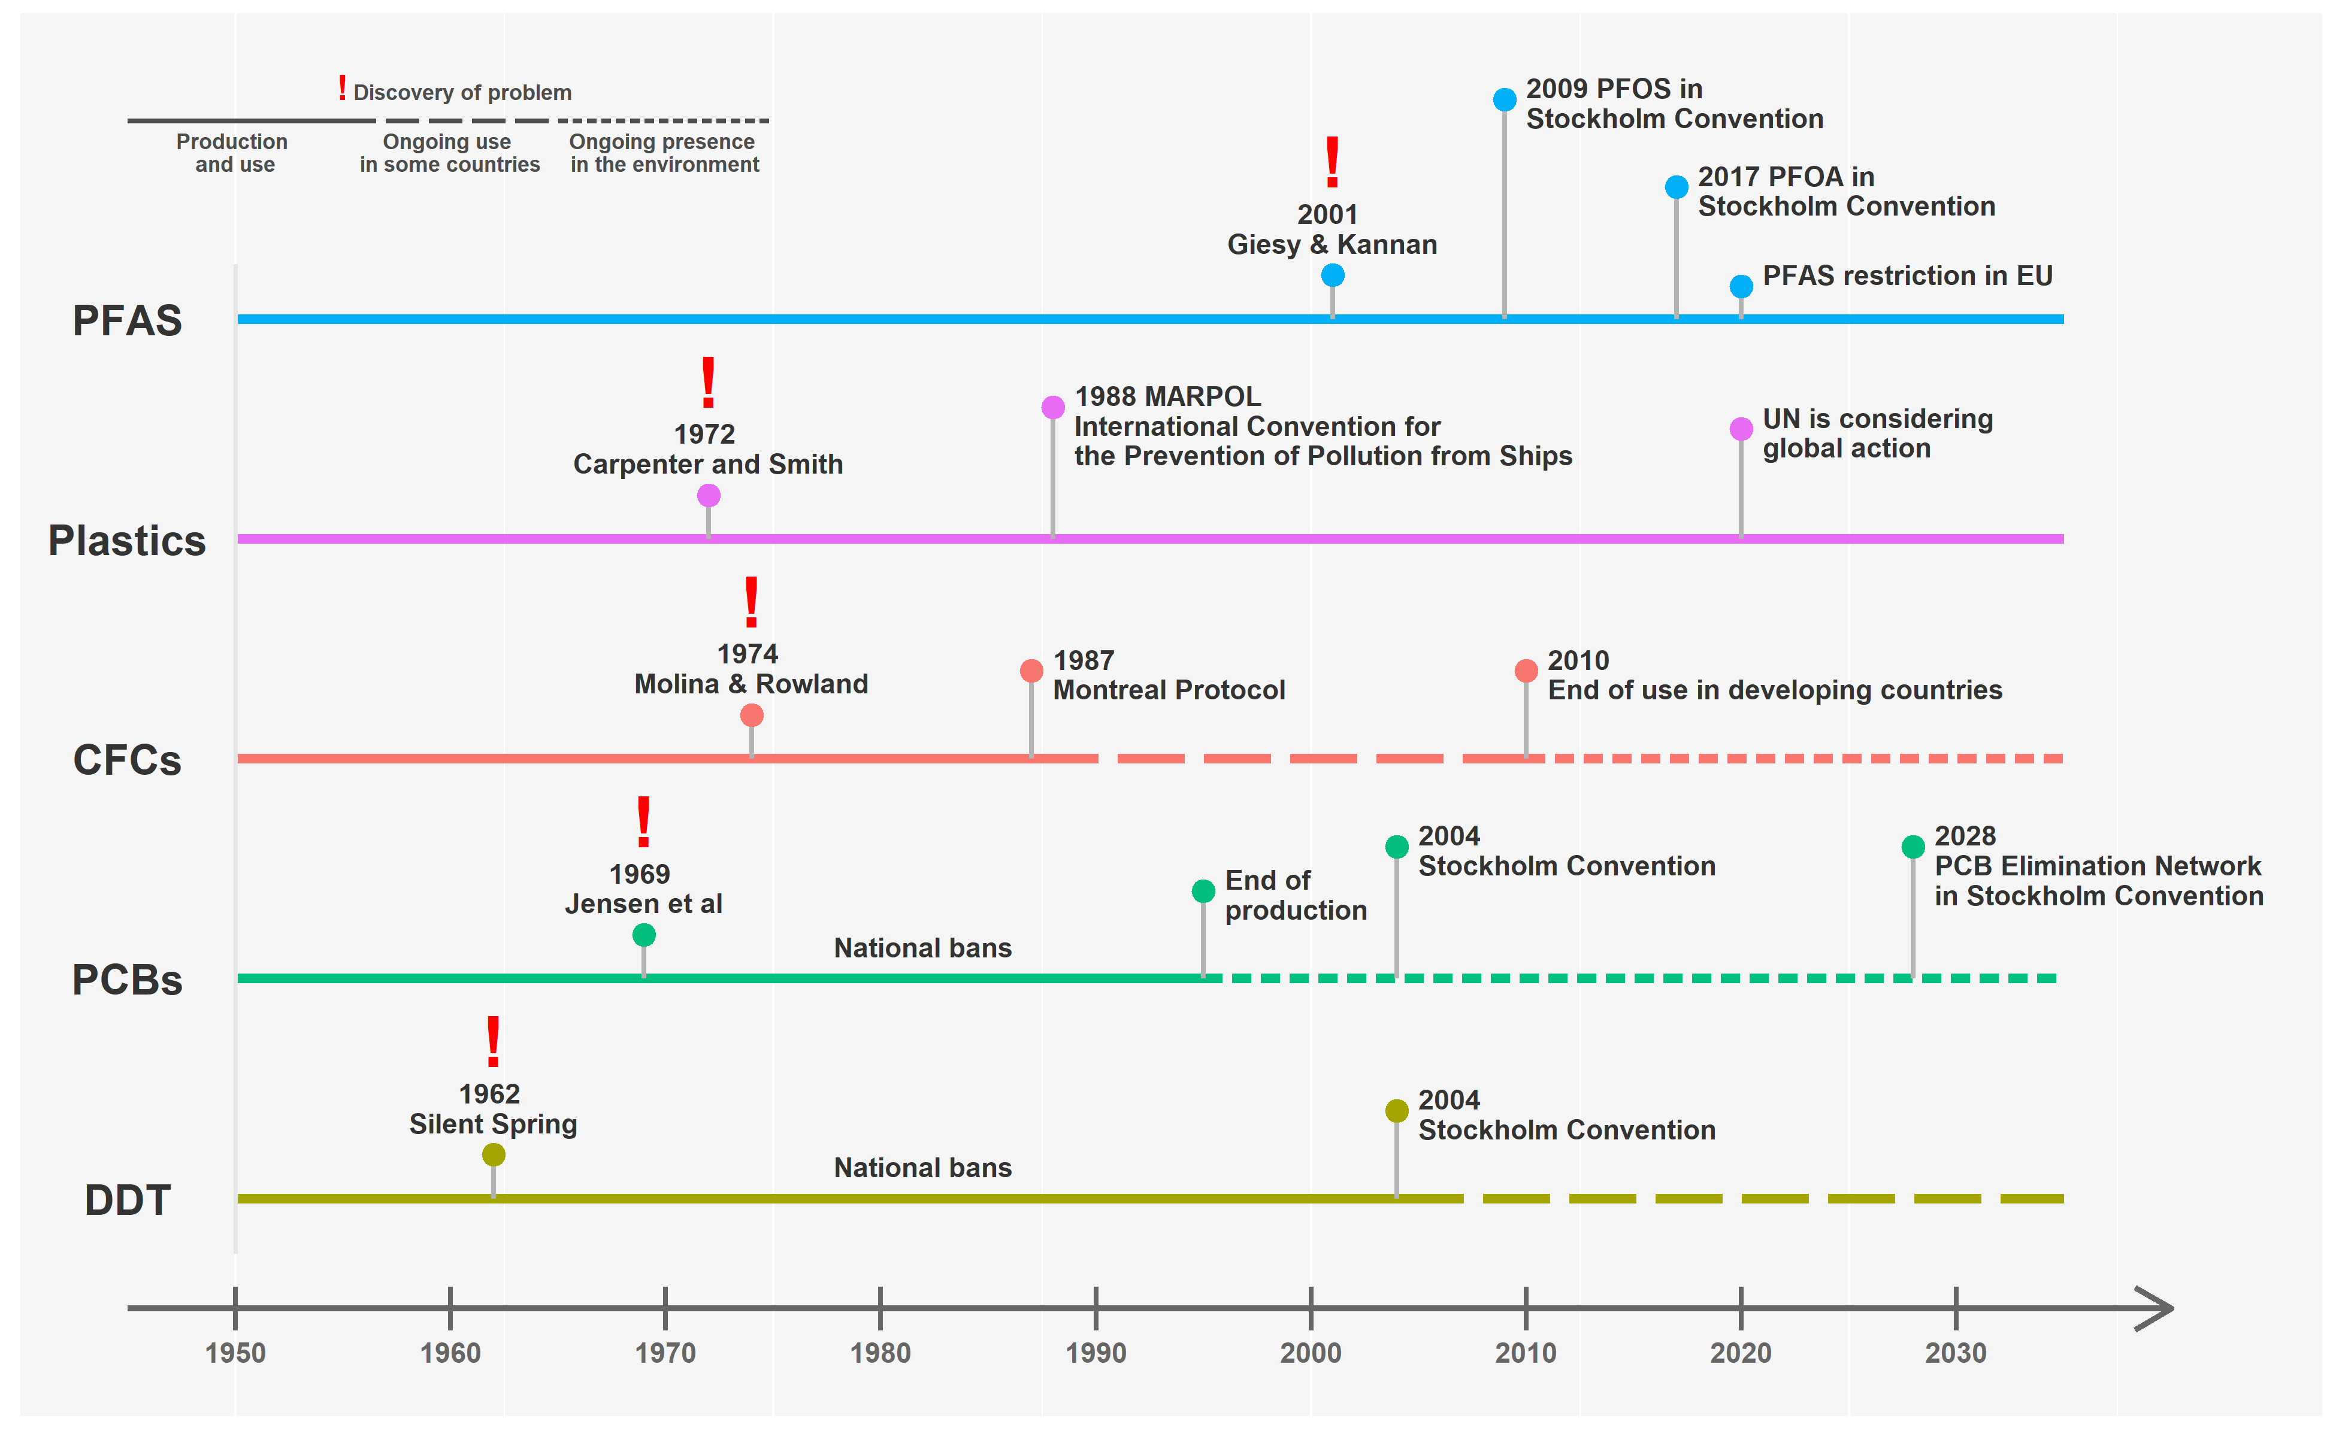
Problems with high persistence

Slide 7
Results
Rainwater levels everywhere higher than the US EPA drinking water health advisories for PFOA and close to Danish guidelines for sum of 4 PFAS
Surface waters: lakes and rivers have levels above the EQS for PFOS and rainwater levels typically around the EQC level
Soils: global ambient soil concentrations higher than the Dutch soil guideline values

Slide 8
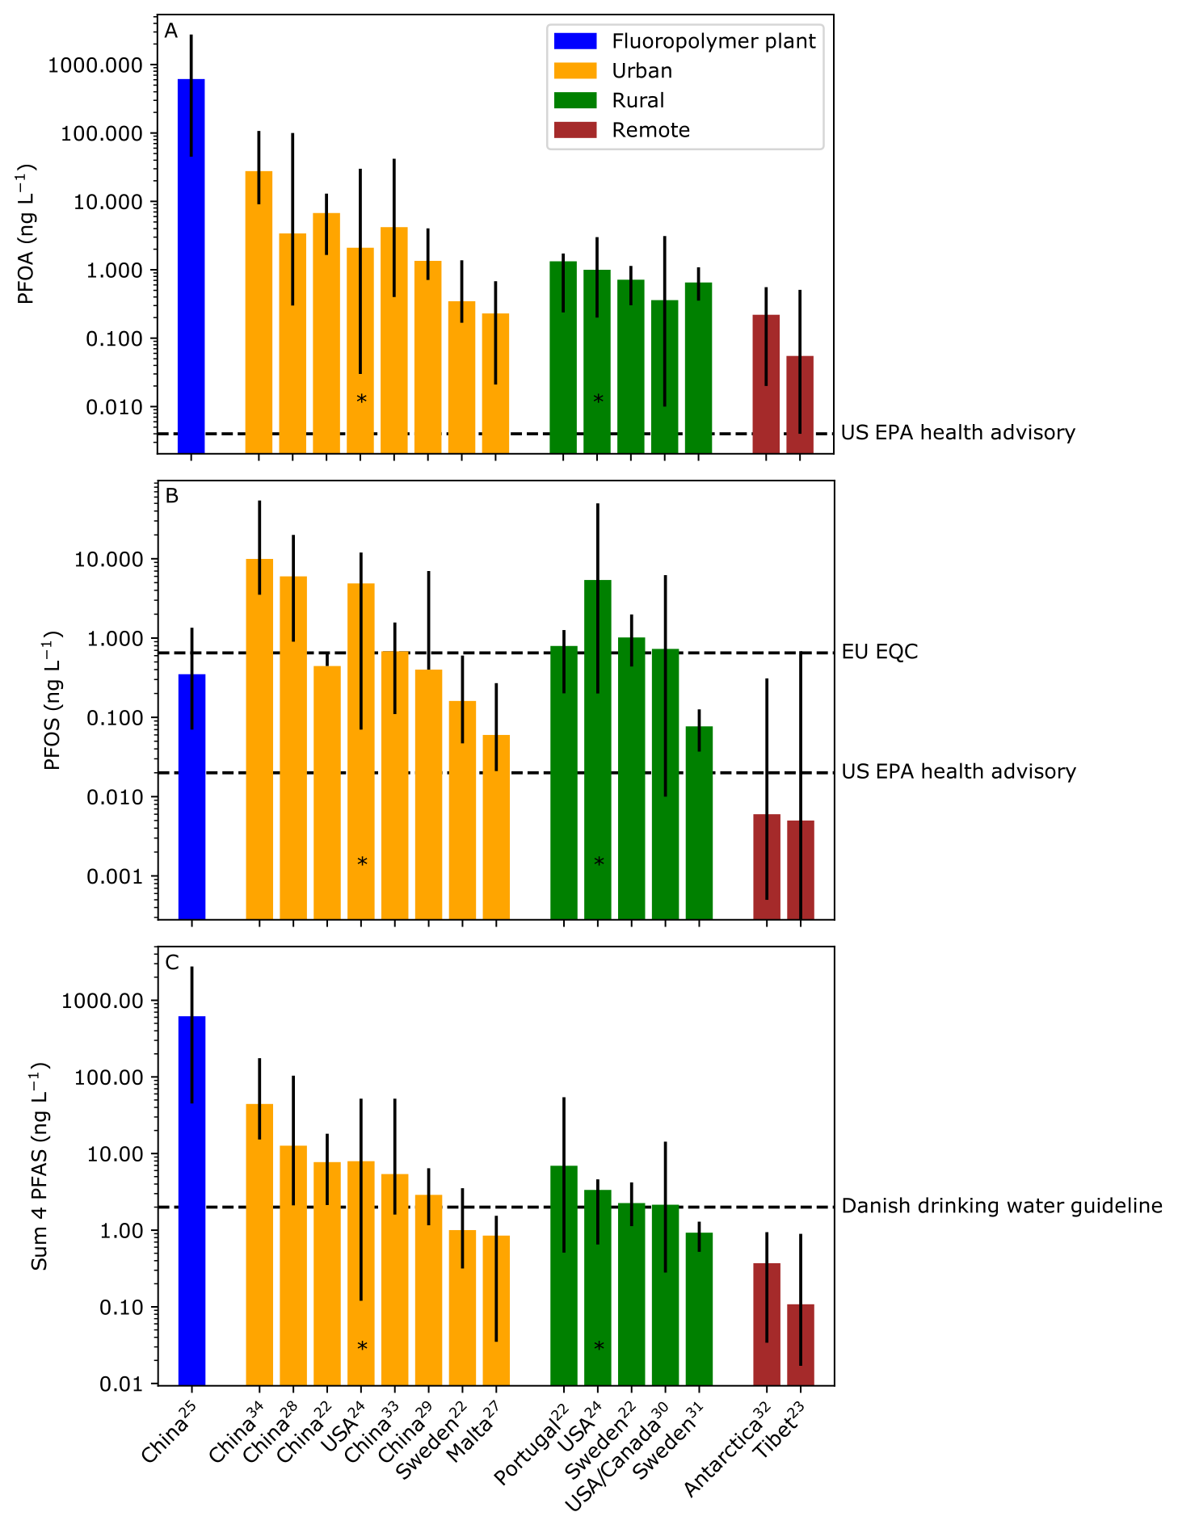

Slide 9
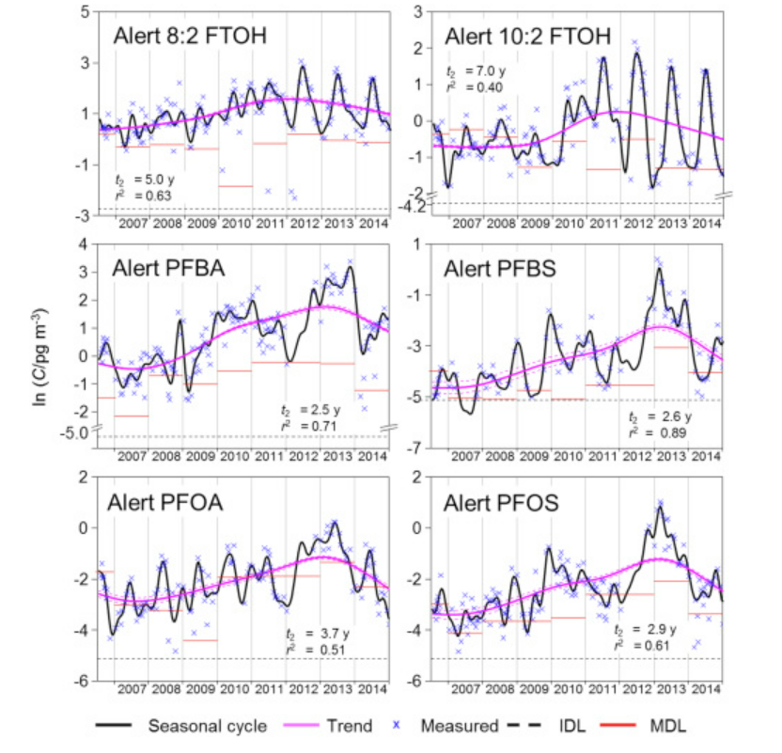
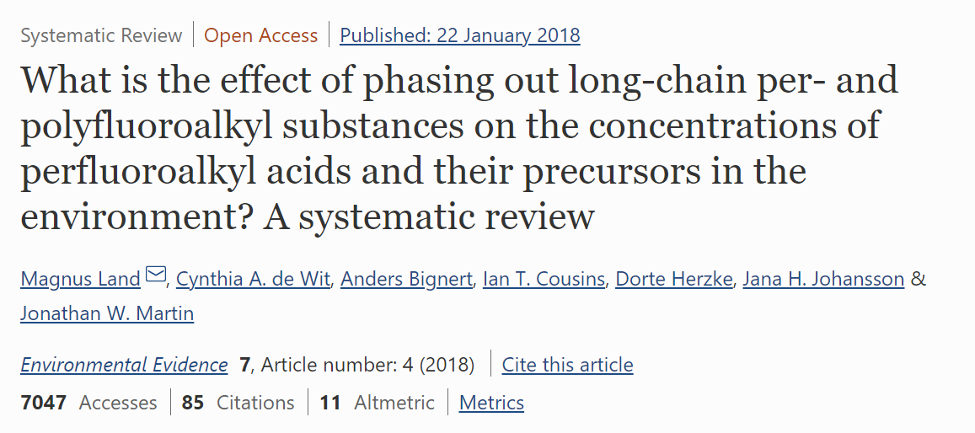
Time trends in environmental media stable

Slide 10
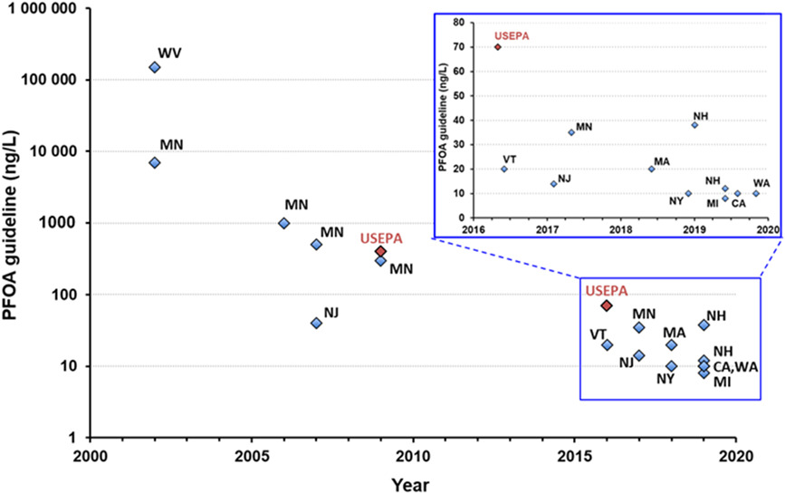
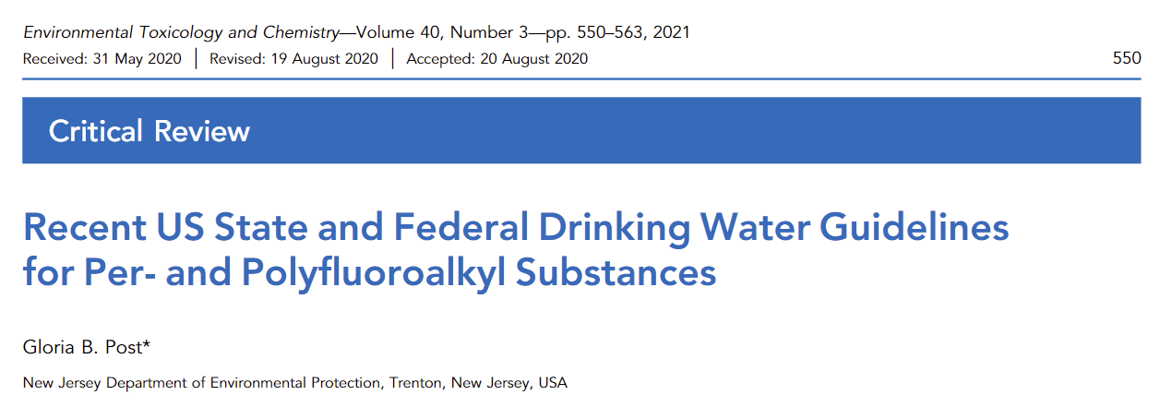
As toxicity knowledge increases drinking water health advisories decrease
Now PFOA guidelines a factor of 37.5 million times lower than in 2002!

Slide 11
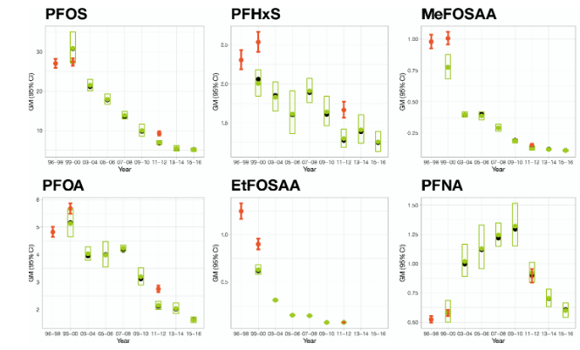
Temporal trends in US blood
Lin et al., (2021) Environ. Int., 157, 106789.

Slide 12
How are we exposed to these 4 PFAS?
Direct dose
Indirect dose
PFOS: diet > dust > air > water
Short-chain PFAAs: water and vegetables more important
Long-chains PFAAs: diet (fish/meat) and dust more important
Diet ultimately contaminated from environment
Water
Water
Diet
Diet
Air
Air
Dust
Dust
100%
90%
80%
70%
60%
50%
40%
30%
20%
10%
0%
Low
Intermediate
High
Gebbink et al., (2021) Environ. Int., 74, 160-169.
Exposure scenario

Slide 13

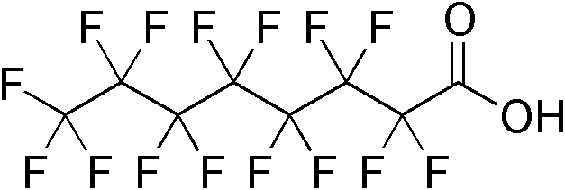

How do these 4 PFAS get in rain?
OH/NOx
Precursor
transformation
Sea spray
aerosols
Direct
emissions
to air
Direct emissions
to waters
Riverine discharge
Oceanic transport

Slide 14
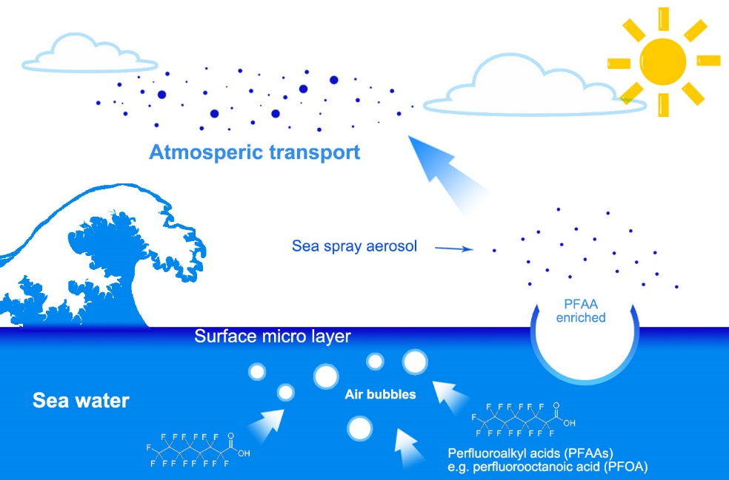
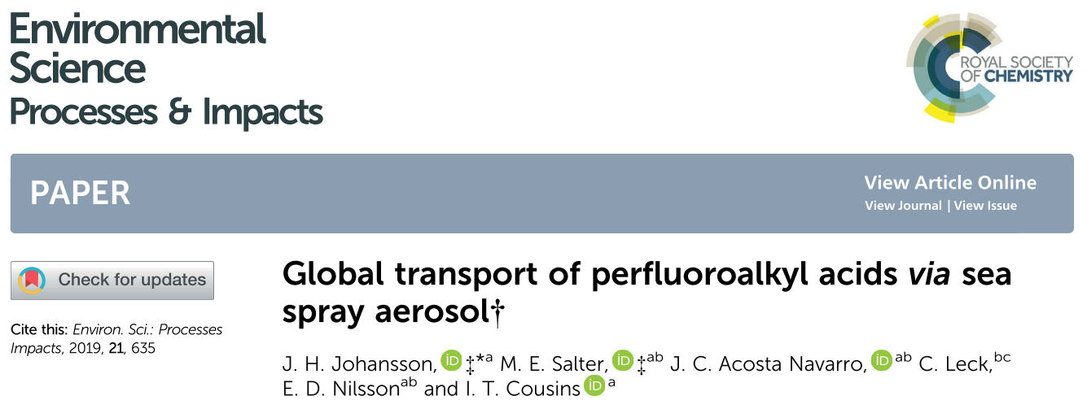
Long-range atmospheric transport

Slide 15
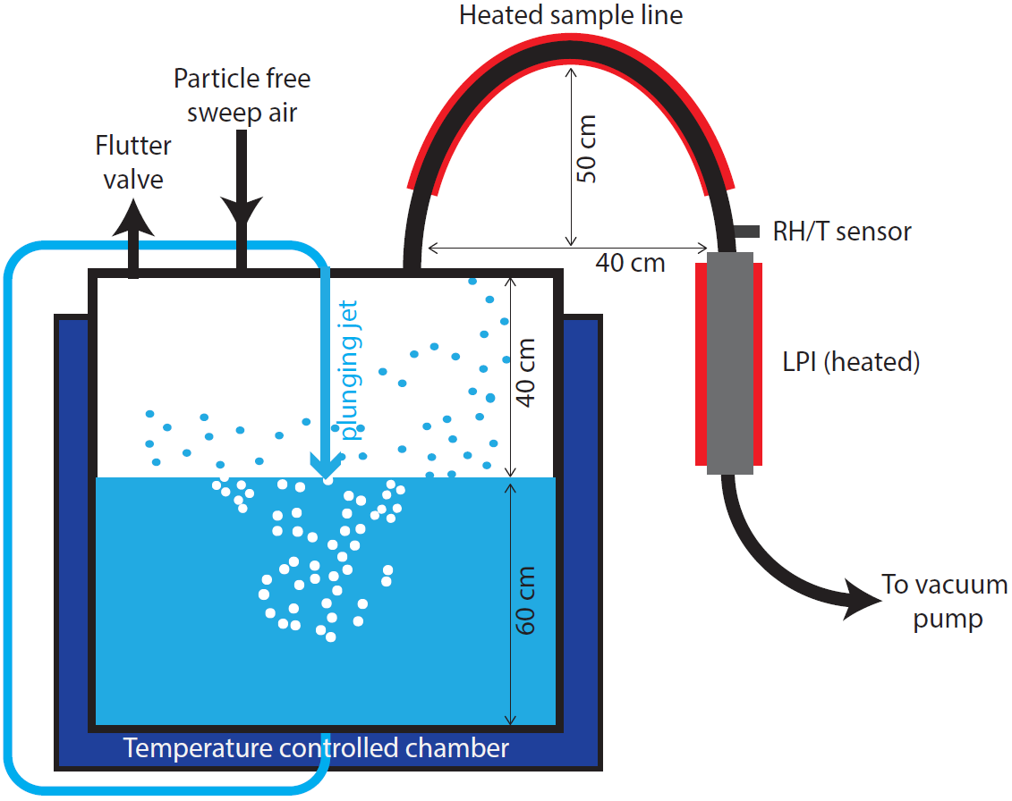
PFAAs spiked to solution of artificial sea salt (35 psu).
Impactor
13 stages
Aerosol and water analysed for PFAAs (UPLC-MS/MS)
and sea salt content (ion chromatography).

Slide 16
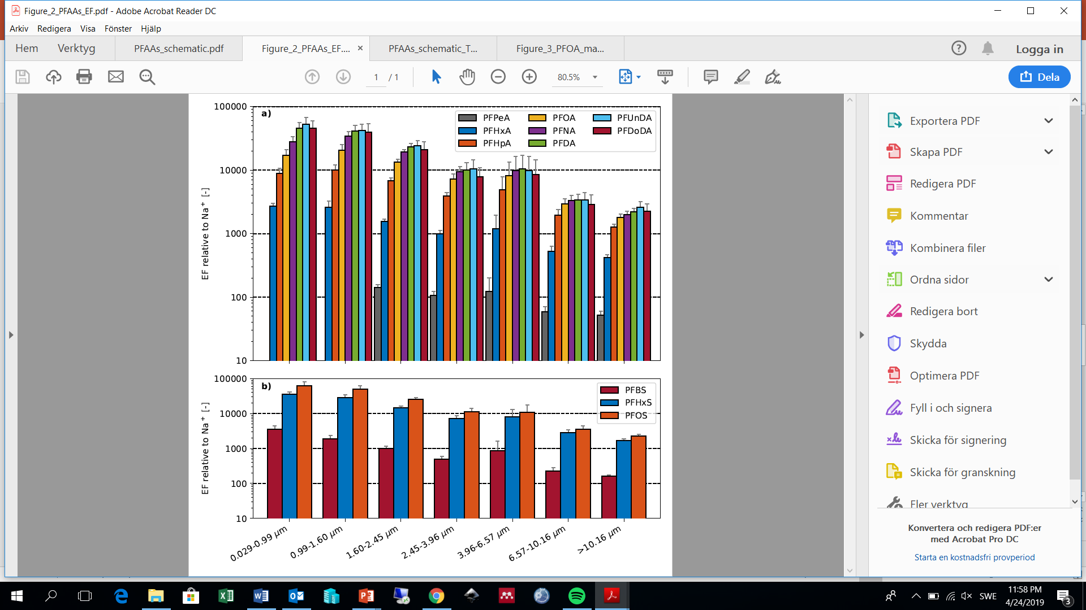
Measured aerosol enrichment factors
Normalised to mass of sea salt tracer Na+
Weeks
Days
Hours
Atmospheric residence time

Slide 17
Conclusions
PFAS cycle in the global hydrosphere
  coastal water resources especially threatened
Long-chain PFAAs phased out, but not declining notably in the atmosphere
  prevents health advisories/guidelines from being attained
Beware of other PFAS doing the same
Let’s finally understand the problems with highly persistent substances

Slide 18
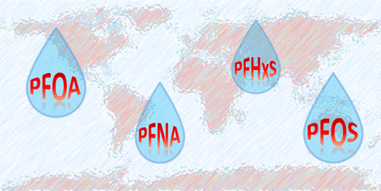
Thank you for your attention!
Thanks also to co-authors and funding

